Slide 1
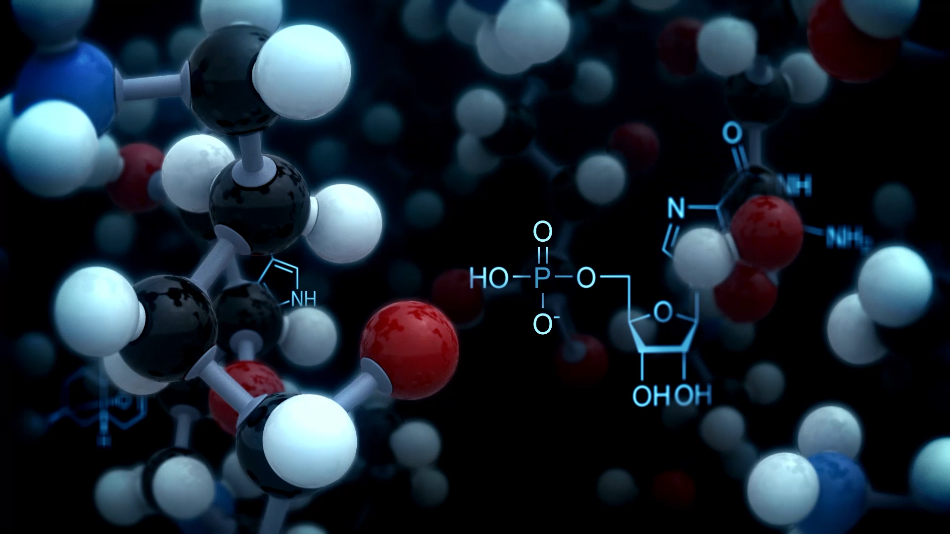
TCGA–HPA Gene-Centric Database Browser
Web-based SQL database interface
using Flask
15 December 2025 FHNW

Slide 2
Assignment Context
Develop a web-based user interface for a SQL database
Backend implemented with Flask
Interactive search and result visualization
Database dump and GitHub repository provided

Slide 3

Motivation
Combining TCGA: sample-level RNA expression with HPA: gene-level protein expression

Slide 4
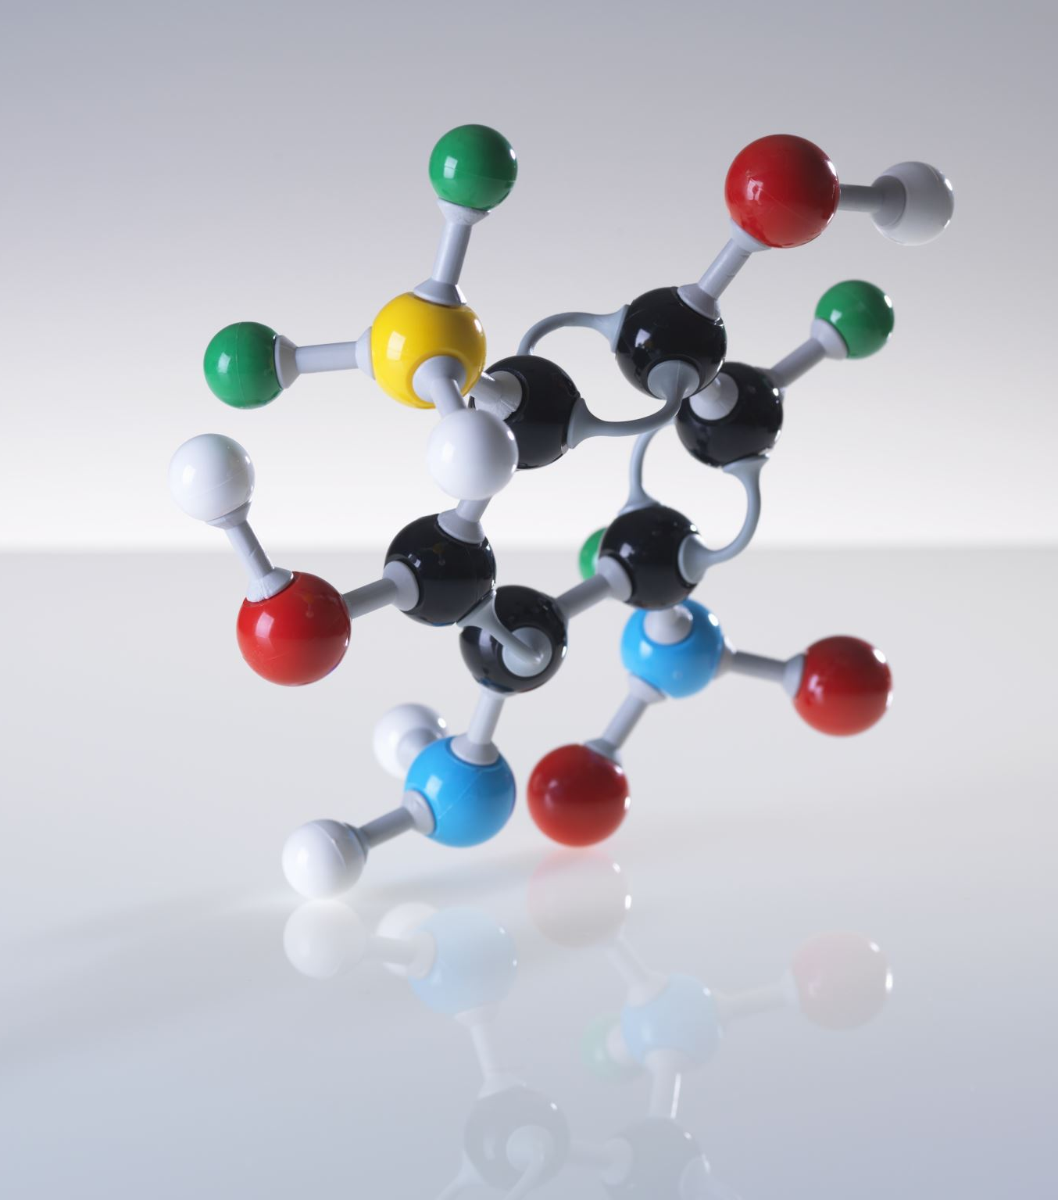
Core Challenge
Structural mismatch
TCGA and HPA describe the same genes
Different granularity:
TCGA → many rows per gene
HPA → one row per gene
Need a unified query model
How can these datasets be queried together without losing their original structure?

Slide 5
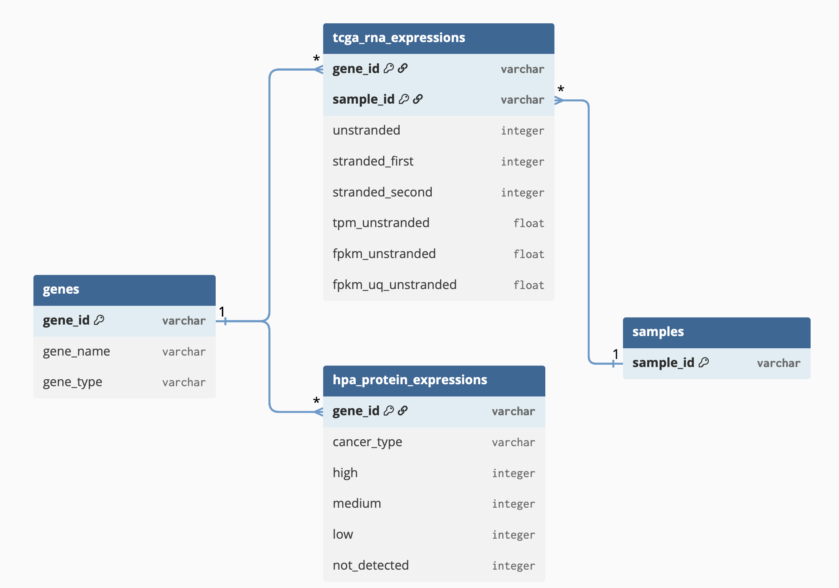
Database Design
Gene-centric relational model
Separate table for genes
TCGA linked via one-to-many relationship
HPA linked via one-to-one relationship
Notes:
Backend: Flask (Python) — Handles routes (endpoints), reads user input from the URL, runs SQL queries, and prepares data for the templates.
Database: MySQL — Stores normalized tables (genes, TCGA expression, HPA summary) and returns query results.
Frontend: HTML + Bootstrap — Renders pages (Home/Resolve/Results) with tables and layout; Bootstrap provides consistent styling quickly.
Visualization: Chart.js — Converts query results into bar charts on the Results page (database-driven statistics).

Slide 6
Project Stack
Flask (Python) Web framework used to define routes (endpoints), handle user input from URLs, execute SQL queries, and connect the database to the web interface.
MySQL Relational SQL database used to store normalized biological data (genes, TCGA expression, HPA summaries).
HTML Used to structure the web pages (home page, results page, tables, forms).
Bootstrap (CSS framework) Used for layout, styling, and responsive design without writing custom CSS from scratch.
Jinja2 (Flask templating engine) Used to dynamically inject database query results into HTML templates (tables, text, charts).
JavaScript Used on the client side to render interactive elements, mainly charts.
Chart.js JavaScript library used to visualize database-derived statistics as bar charts.
JSON (JavaScript Object Notation) Data format used internally to transfer query results from Flask (Python) to JavaScript for chart rendering.

Slide 7
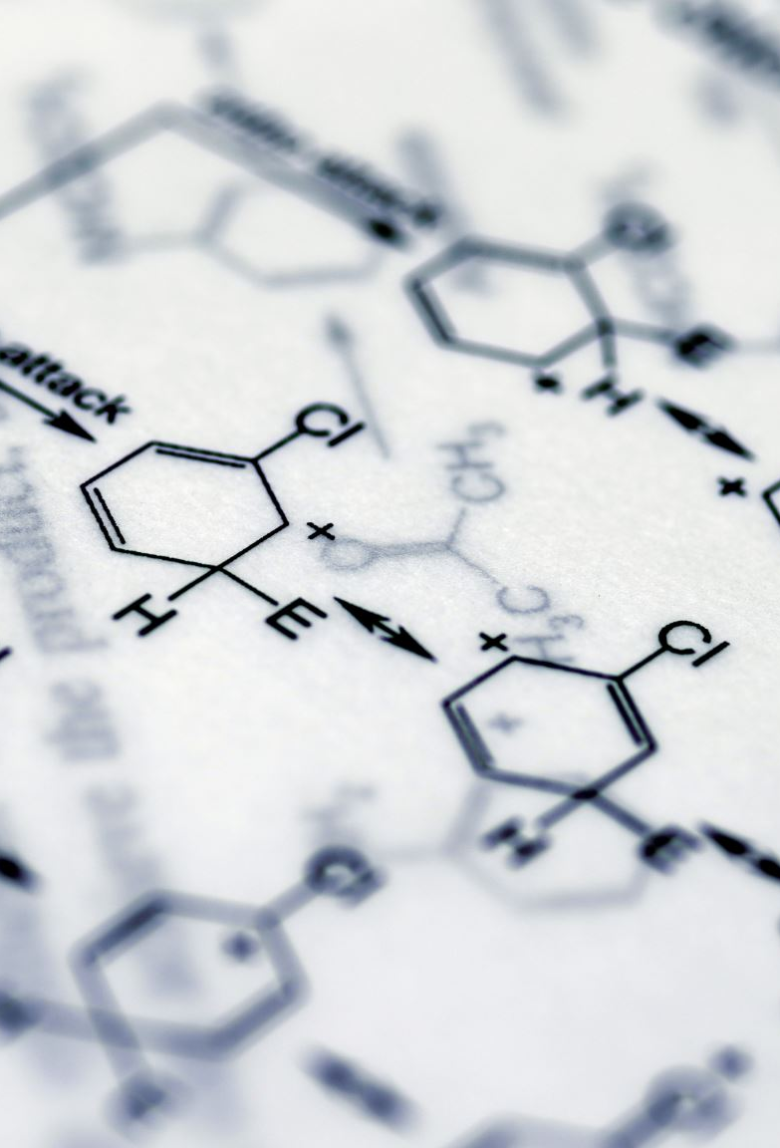
Data Sources
TCGA
RNA-seq expression
One row per (sample, gene)
Numeric values
Many rows per gene
Human Protein Atlas (HPA)
Protein expression summary
One row per gene
Categorical levels (high / medium / low / not detected)

Slide 8
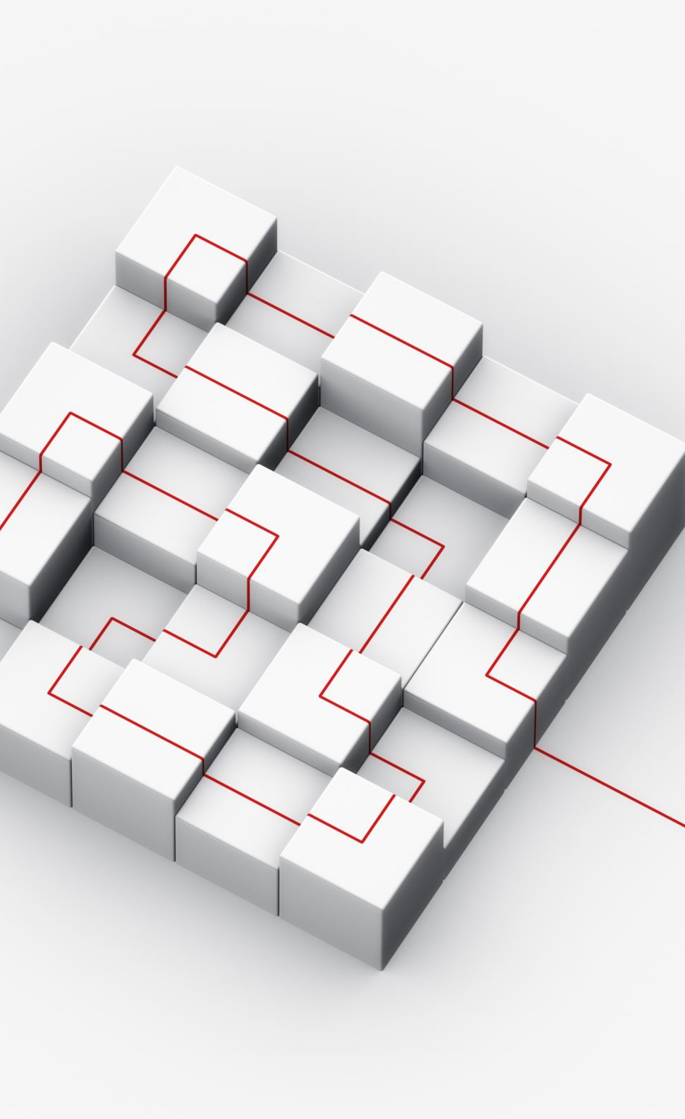
Application Architecture
Backend: Flask (Python) — Handles routes (endpoints), reads user input from the URL, runs SQL queries, and prepares data for the templates.
Database: MySQL — Stores normalized tables (genes, TCGA expression, HPA summary) and returns query results.
Frontend: HTML + Bootstrap — Renders pages (Home/Resolve/Results) with tables and layout; Bootstrap provides consistent styling quickly.
Visualization: Chart.js — Converts query results into bar charts on the Results page (database-driven statistics).

Slide 9
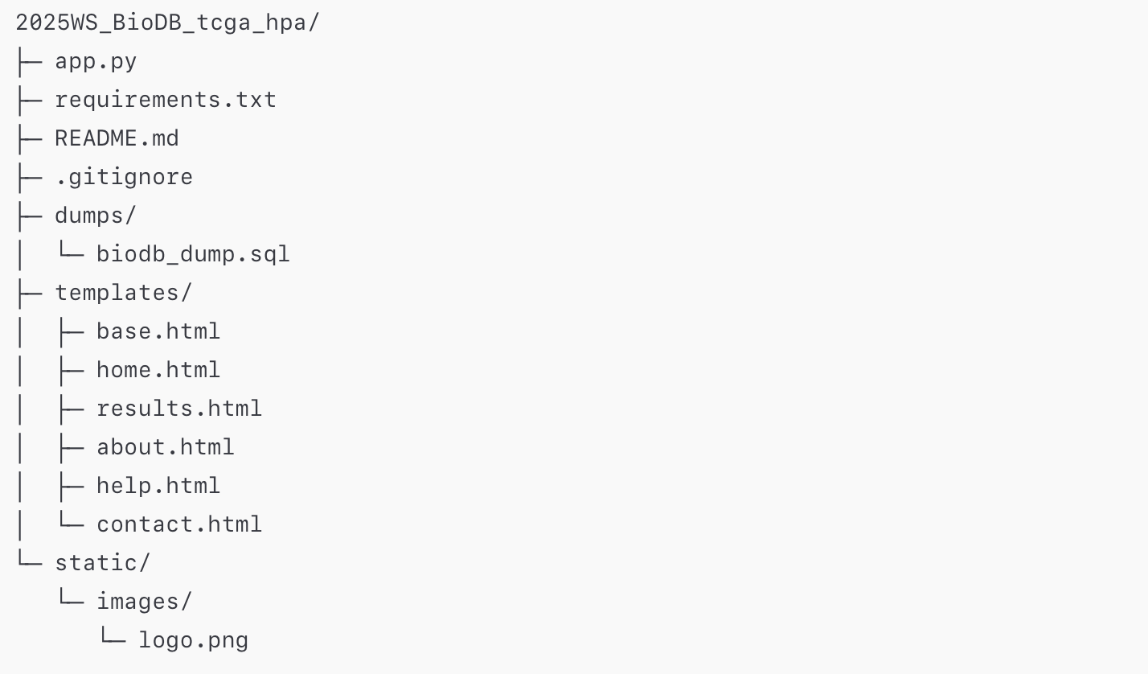
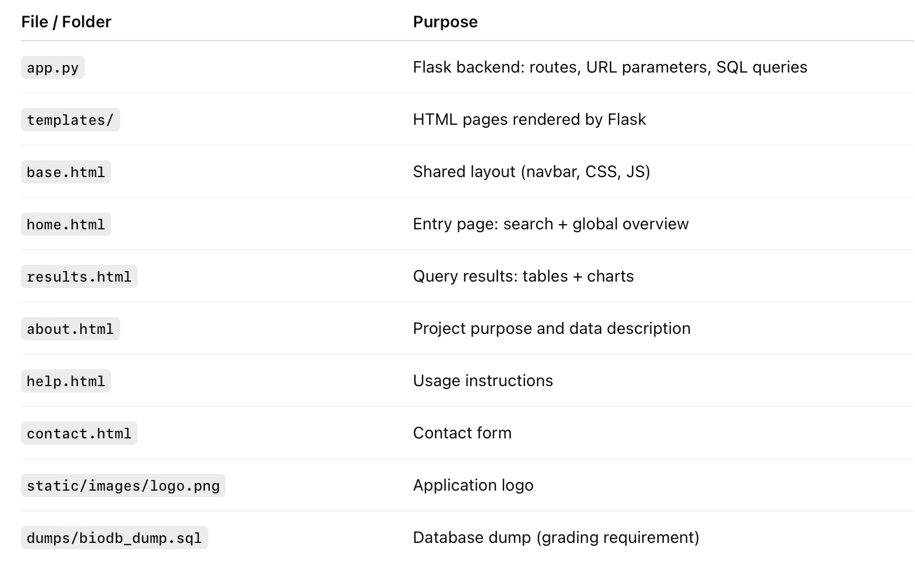
Project structure

Slide 10
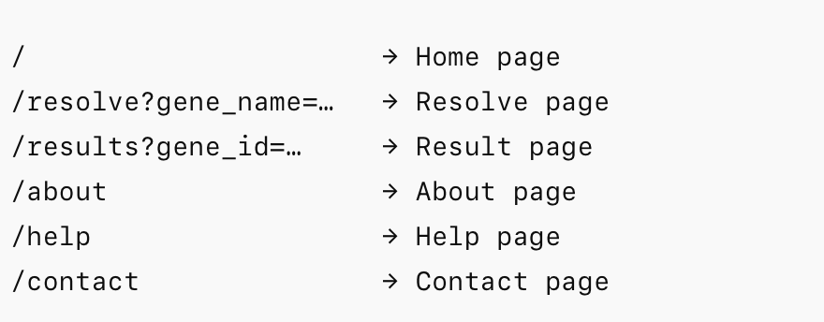
End PoINTS

Slide 11

Home Page Features – DEMO 1
Title and project description
Gene search field with search examples
Preview tables
External link to HPA for each gene_name
Entry point to database exploration
Nav bar

Slide 12
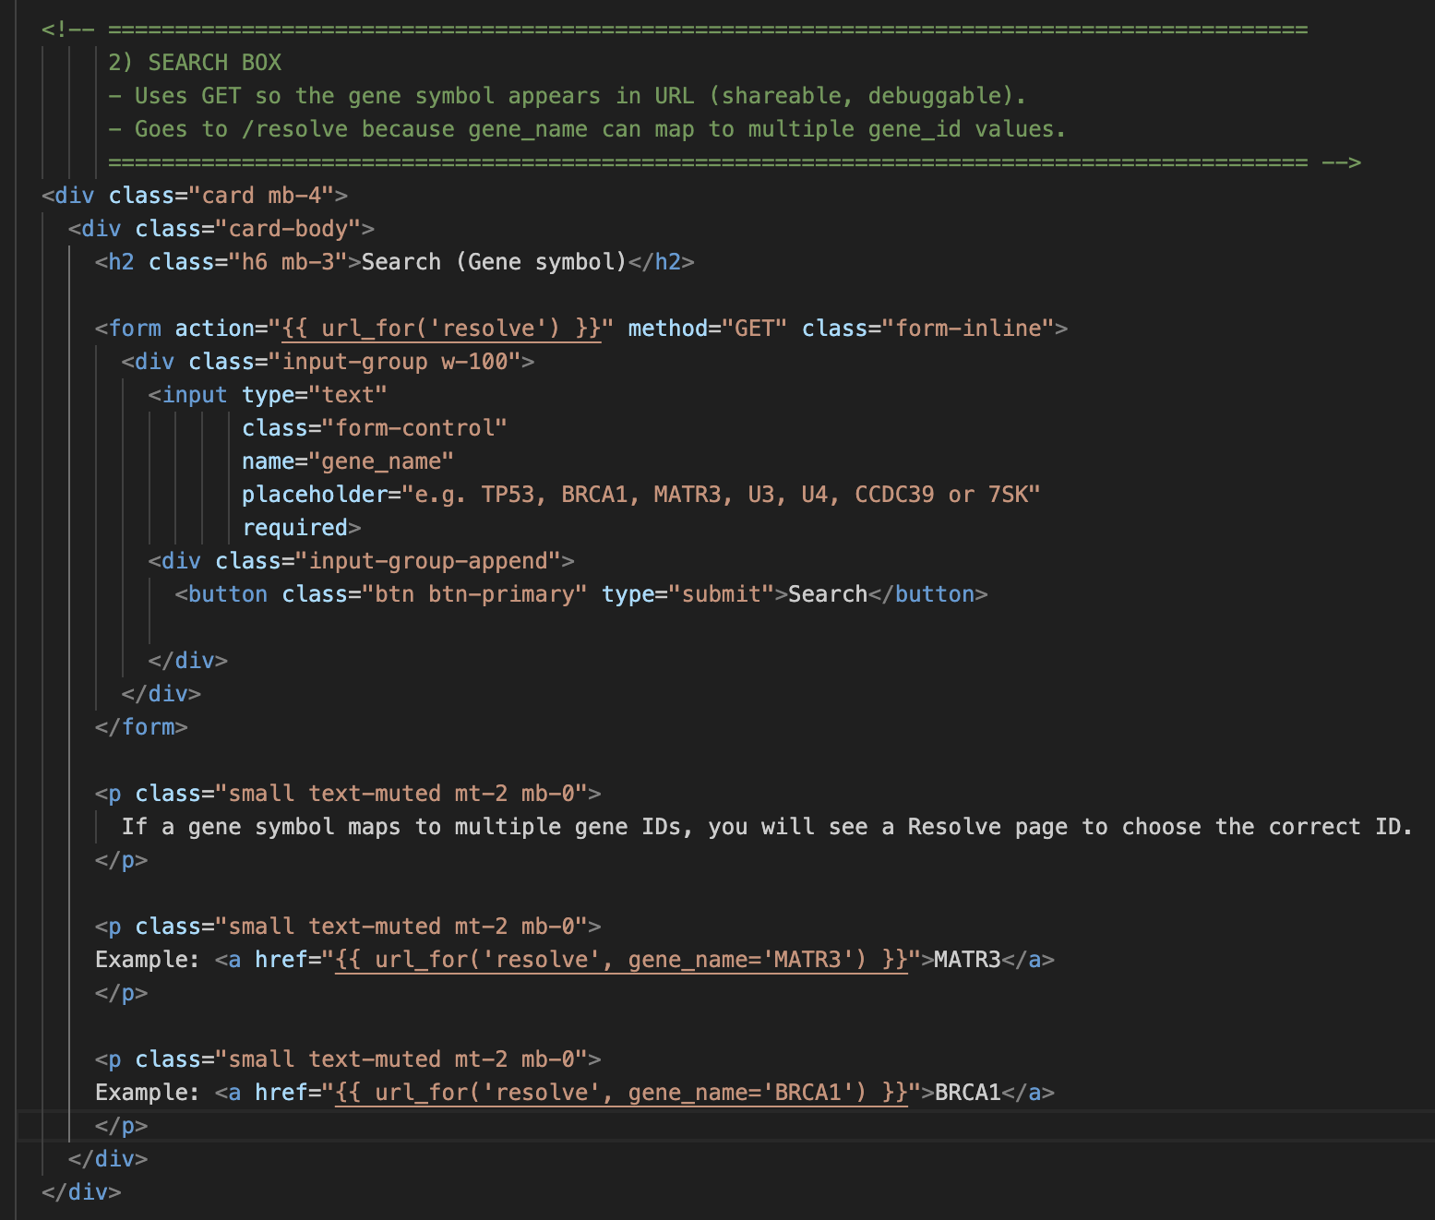
Get method SEARCH BAR
Used to create urls per each gene_id (determined by query of a gene_name)

Slide 13
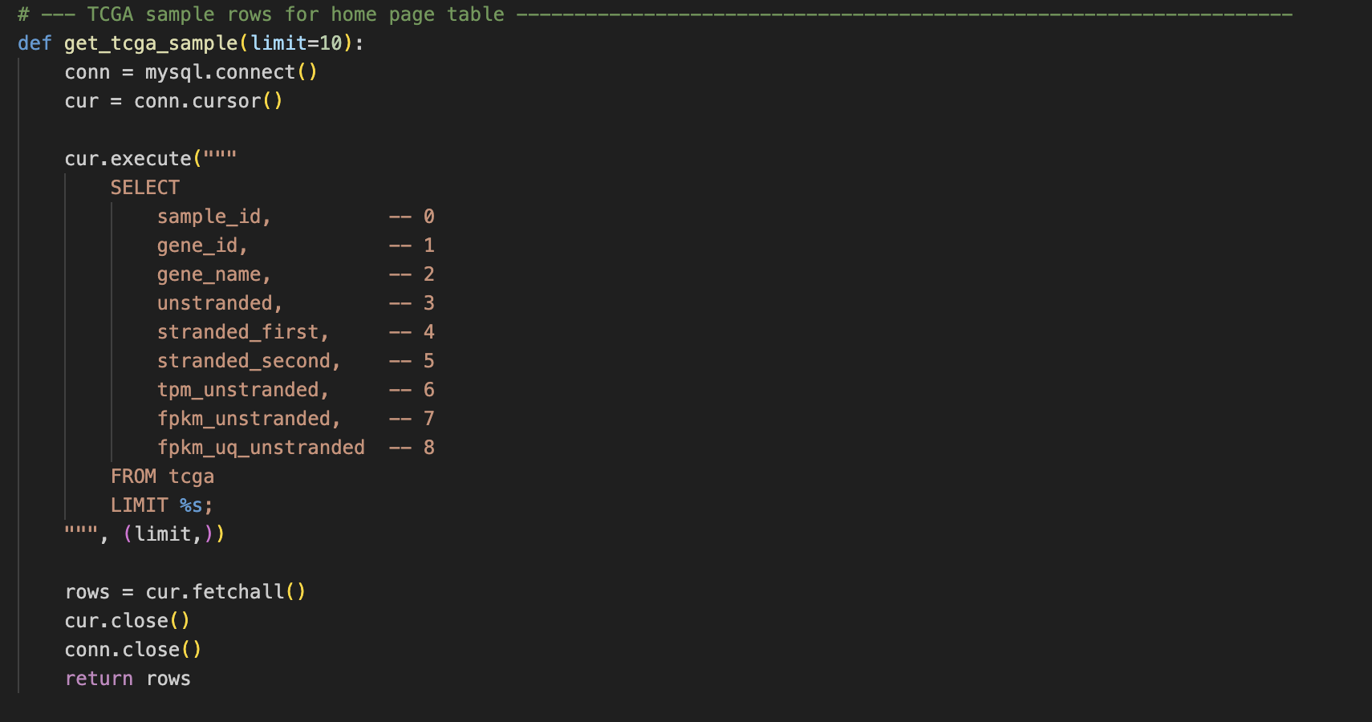
Table query for Home Page

Slide 14
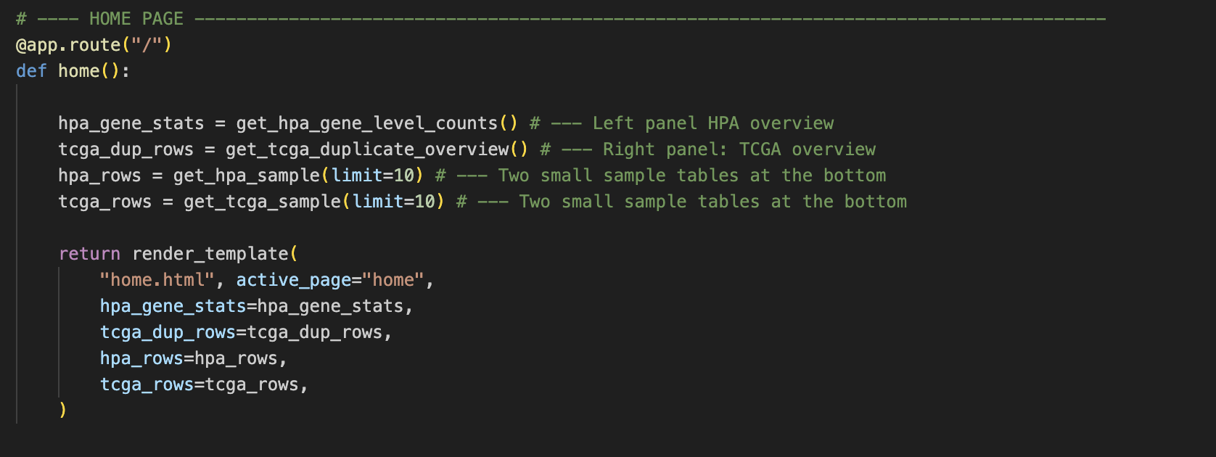
ROUTES

Slide 15
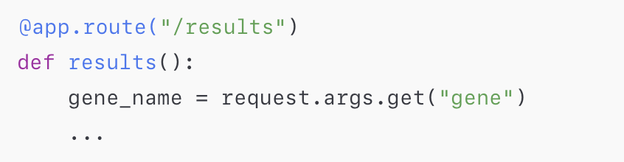
Result Page (StatS & Graps) - DEMO 2 Search → Results
Bar charts generated from database queries
HPA protein category distribution
TCGA RNA expression per sample
Statistics are query-specific

Slide 16
Additional Pages – DEMO 3
About page
Help page
Contact page
Resolve page
Base.html --> Shared layout handled via base.html (DRY design)

Slide 17
Assignment Checklist
Flask-based web interface ✔
SQL database backend (MySQL) ✔
Home page with:
Title ✔
Purpose / About text ✔
Database statistics ✔
Search field ✔
Result page with:
Result tables ✔
Additional result page:
Graphical statistics (Chart.js) ✔
External database links ✔
Additional pages:
Contact / About / Help ✔
GitHub repository and database dump ✔

Slide 18

Thank you

